Slide 1

Project Title -Seasonal Agriculture Performance Analysis
Student Name :-Saddala Avinish Reddy
College Name:-Manipal university Jaipur
AICTE STU ID : (STU6a27c55ff174b1780991327)

Slide 2

PROBLEM STATEMENT
(Agricultural activities are influenced by seasonal variations in environmental conditions, farming practices, resource availability and market conditions. As a result, agricultural performance may differ from one season to another. However, raw agricultural data does not clearly explain how agricultural performance changes across seasons or what patterns can be observed in different seasonal conditions. The problem is to analyze the given agricultural dataset and investigate seasonal differences in agricultural performance by identifying meaningful patterns, trends, relationships and variations within the available data.

Slide 3
Project Description This project focuses on analyzing agricultural data to understand how farming performance changes across different seasons, regions, environmental conditions, resource usage, and economic factors. The dataset contains information related to agricultural activities, crop production, farming practices, environmental conditions, and financial performance.

Slide 4
Project Description
The project involves data cleaning, exploratory data analysis, statistical analysis, and data visualization to identify meaningful seasonal patterns and variations. Different agricultural factors will be compared across seasons to understand their impact on crop production, resource consumption, and economic outcomes. Relationships between variables such as environmental conditions, resource usage, and agricultural performance will also be investigated.
The analysis will use suitable charts, graphs, summary statistics, and comparisons to identify trends, differences, unusual observations, and important relationships in the data. The findings will be interpreted based on evidence from the dataset and used to develop data-driven conclusions and recommendations for better seasonal agricultural planning and decision-making.

Slide 5

WHO ARE THE END USERS?
Farmers – To understand seasonal crop performance and improve farming decisions.
Agricultural Planners – To plan crops, resources, and activities based on seasonal trends.
Government Agricultural Departments – To support policies and agricultural development programs.
Agricultural Researchers – To study seasonal patterns and environmental impacts on farming.
Agribusinesses – To understand production and economic trends for better planning.
Agricultural Consultants – To provide data-driven recommendations to farmers and organizations.

Slide 6

Technology Used
Python – Main programming language for data analysis.
Pandas – Data cleaning, manipulation, and analysis.
NumPy – Numerical calculations and data processing.
Matplotlib – Creating charts and visualizations.
Seaborn – Statistical data visualization.
Google colab – Developing and documenting the complete project.

Slide 7
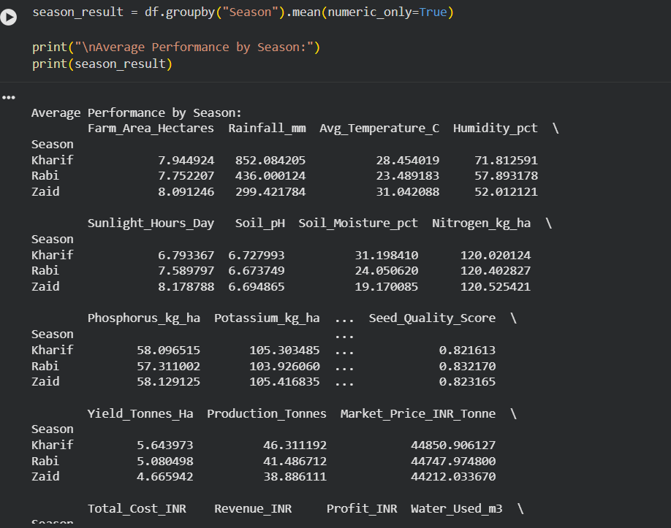
RESULTS

Slide 8
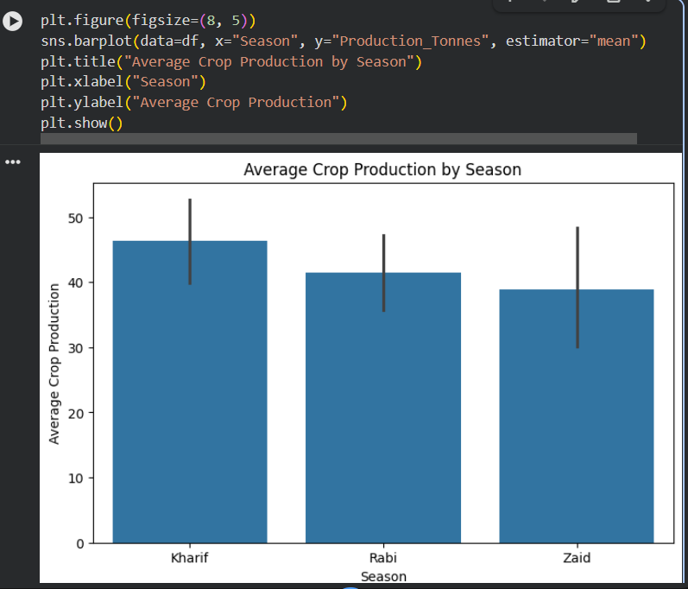
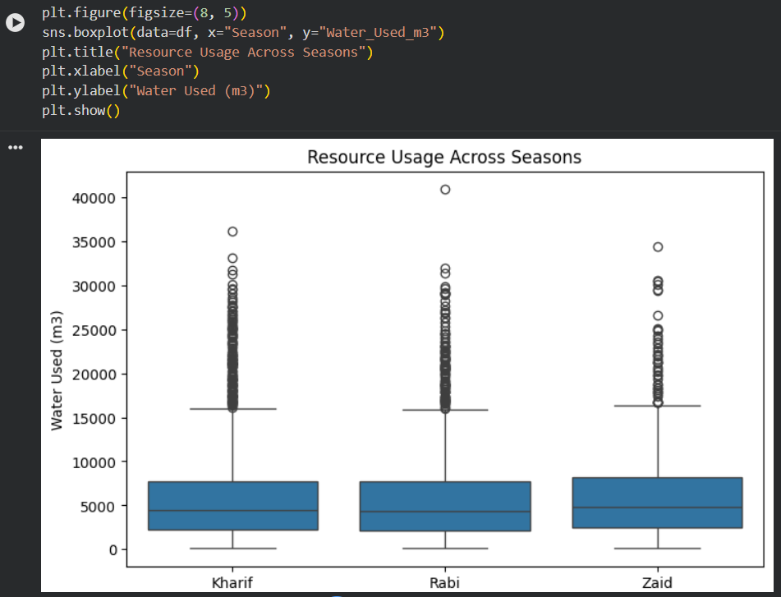
RESULTS
[Add screen shots of your code ]

Slide 9
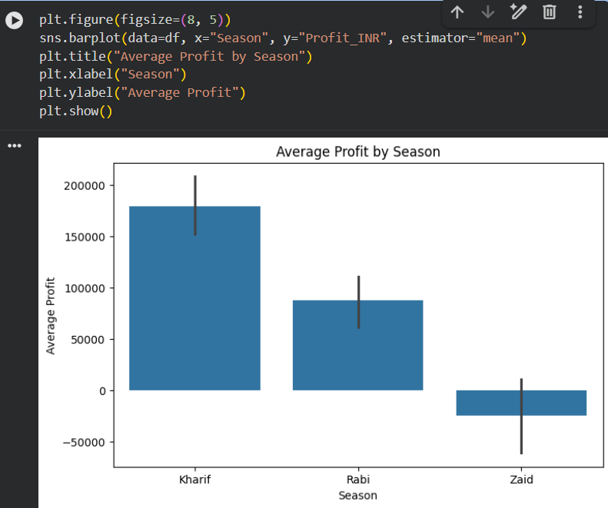
RESULTS
[Add screen shots of your code ]

Slide 10
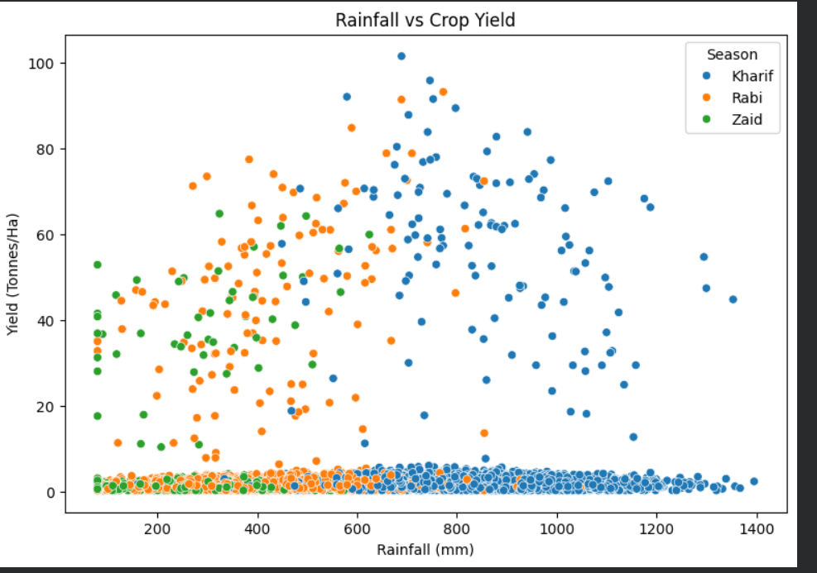
RESULTS
[Add screen shots of your code ]

Slide 11
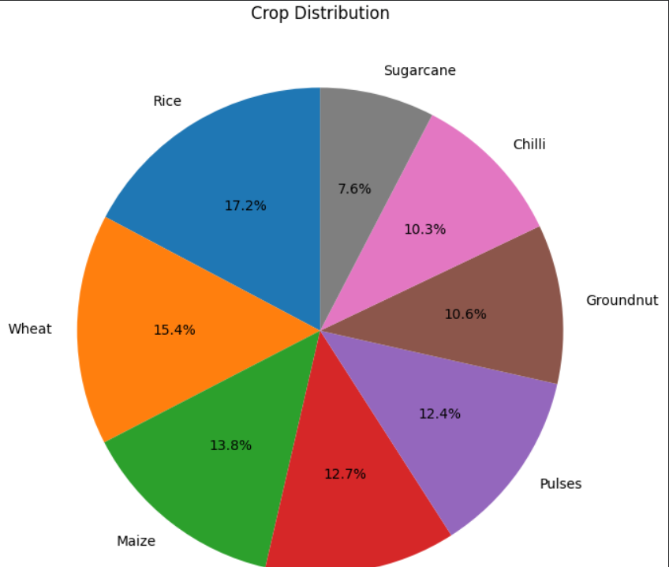
RESULTS
[Add screen shots of your code ]

Slide 12
Future scope
Develop machine learning models to predict crop yield based on seasonal and environmental conditions.
Use weather forecasting data to provide early predictions for upcoming seasons.
Build a real-time agricultural dashboard to monitor crop performance, weather, resources, and market conditions.
Expand the analysis to include more regions, crops, and multiple years of data.
Develop a crop recommendation system that suggests suitable crops for different seasons and regions.
Predict water and fertilizer requirements to improve resource efficiency

Slide 13
GitHub Link
https://github.com/avanishsaddala/Seasonal-Agriculture-Performance-Analysis

Slide 14
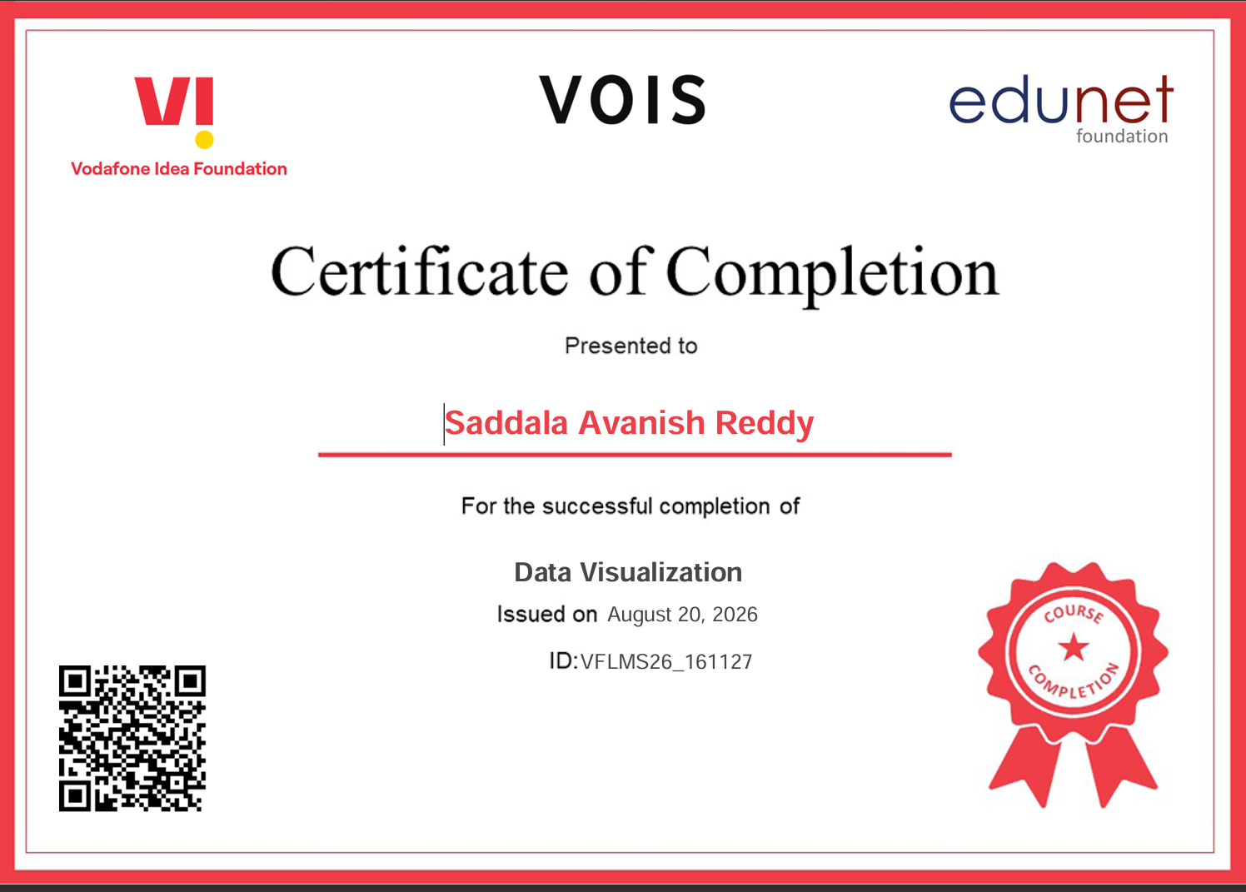
VOIS Course completion certificate - Course name- Data Visualization

Slide 15
Thank you
.
.

